Slide 1
LA TIRZEPATIDE: RISPOSTE DAGLI STUDI SURMOUNT
UBERTO PAGOTTO
Dipartimento di Scienze Mediche e Chirurgiche
UOC Endocrinologia e Prevenzione e Cura del Diabete
Policlinico di S.Orsola IRCCS Alma Mater Università di Bologna

Slide 2
Ai sensi dell’art. 76 del Regolamento applicativo dell’Accordo Stato-Regioni 02.02.2017, dichiaro che negli ultimi due anni ho avuto i seguenti rapporti anche di finanziamento con i seguenti soggetti portatori di interessi commerciali in campo sanitario:
Membro di Advisory Board:
Novo Nordisk, Sciterion, Boehringer Ingelheim, Pfizer, Lilly Italia, Lilly Corporate
Speaker fee:
Lilly Italia, Novo Nordisk, Astra-Zeneca, Bruno Farmaceutici, Rhythm Pharma, Merck, IQVIA

Slide 3
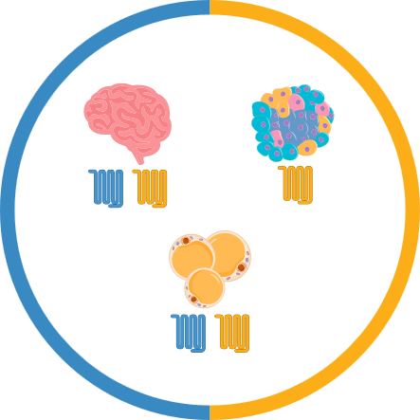

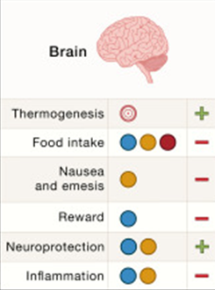
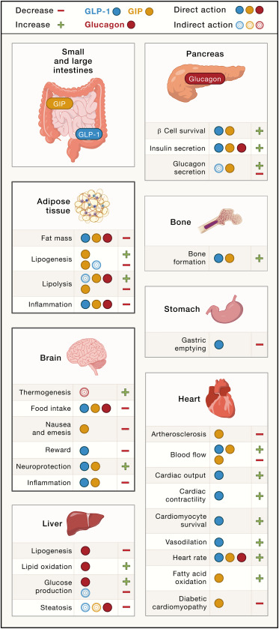
PATHWAYS AND METABOLIC EFFECTS OF GIP AND GLP-1
Kusminski CM et al Cell 2024

Slide 4
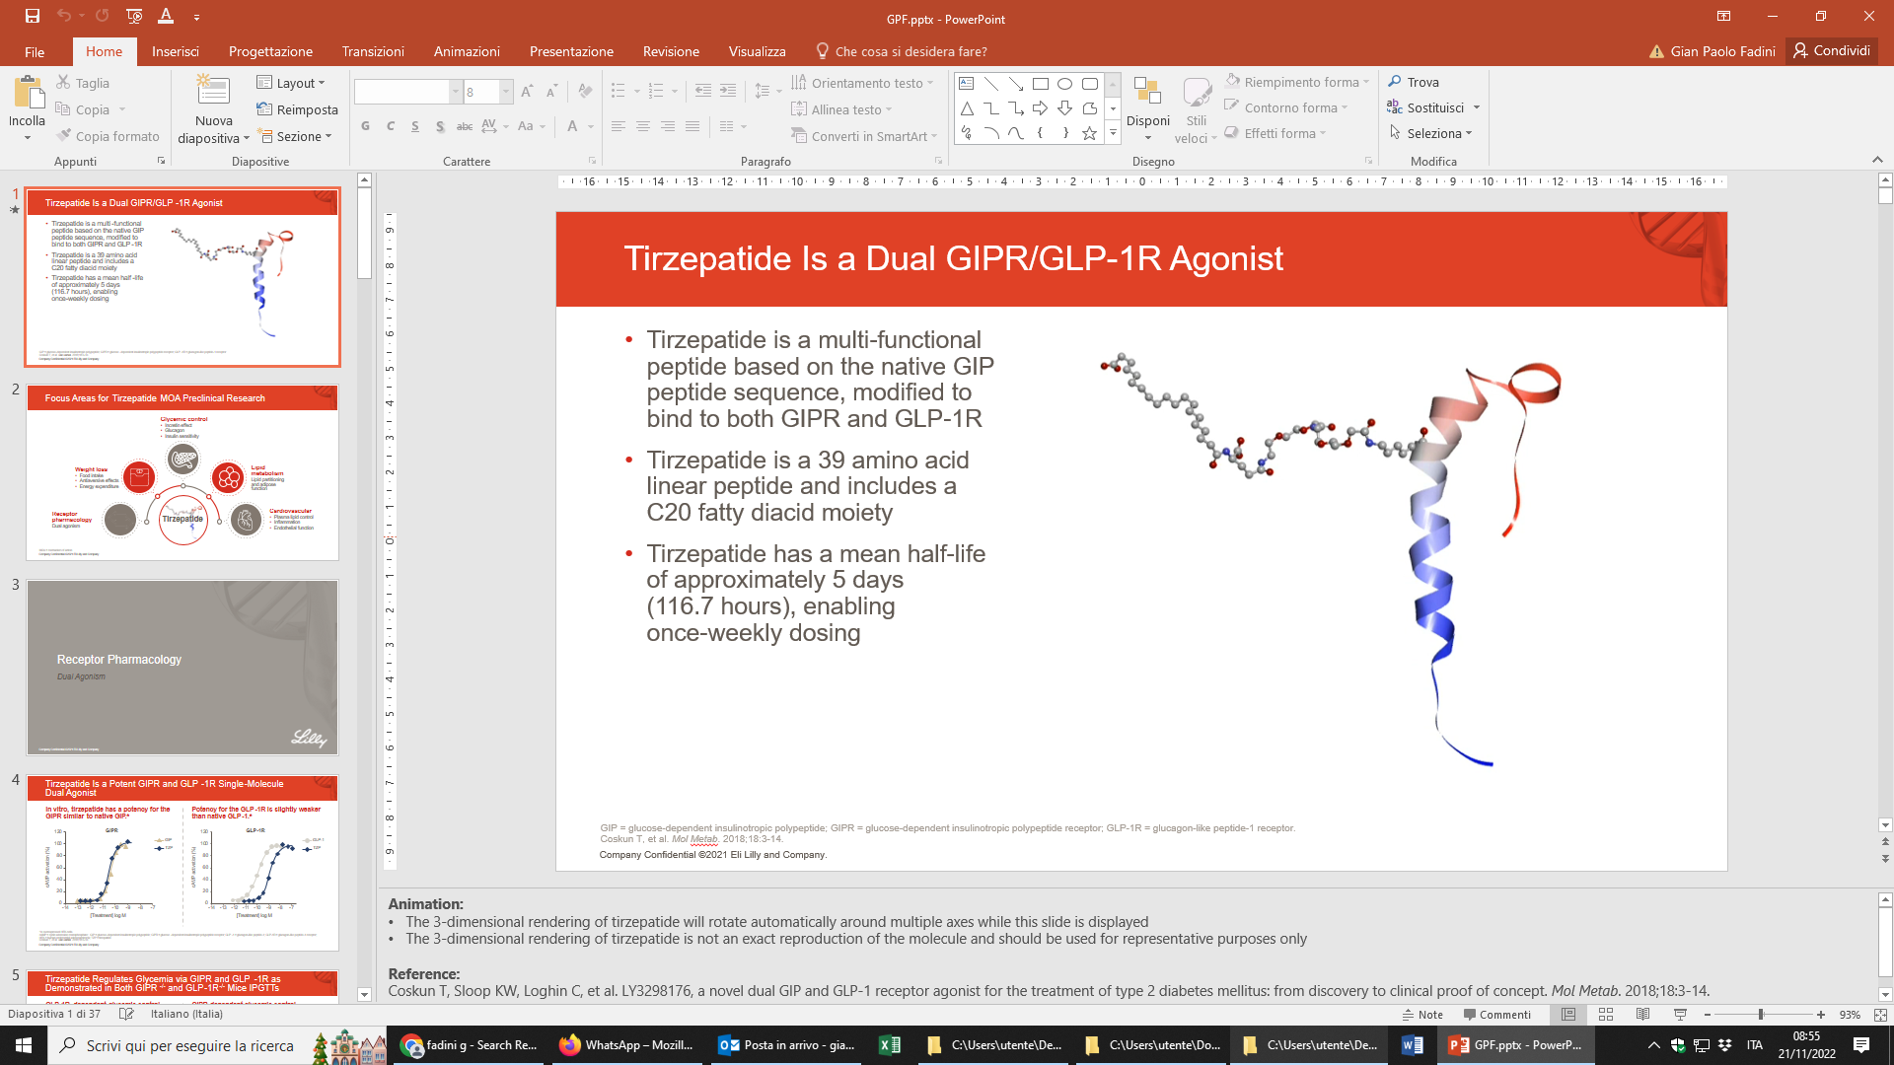
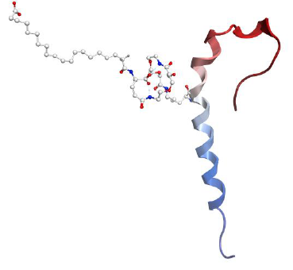
TIRZEPATIDE IS A UNIMOLECULAR DUAL GIPR / GLP-1R AGONIST
Tirzepatide is a multi-functional peptide based on the native GIP peptide sequence, modified to bind to both GIPR and GLP-1R
Tirzepatide is a 39 amino acid linear peptide and includes a C20 fatty diacid moiety
Tirzepatide has a mean half-life of approximately 5 days (116.7 hours), enabling once-weekly dosing
Coskun T. et al. Mol Metab 2018

Slide 5
TIRZEPATIDE CLINICAL DEVELOPMENT PROGRAM
For Obesity and Obesity-Related Complications
Obesity: (Phase 3)
SURMOUNT-1
SURMOUNT-2
SURMOUNT-3
SURMOUNT-4
SURMOUNT-5
Obesity and Obesity-Related Complications
SURMOUNT-ADOLESCENTS
SURMOUNT-MAINTAIN
SURMOUNT-J
SURMOUNT-CN
NASH: SYNERGY-NASH (Phase 2)
HFpEF: SUMMIT (Phase 3)
Kidney Disease: TREASURE-CKD (Phase 2 MoAª)
Obstructive Sleep Apnea:
SURMOUNT-OSA (Phase 3)
Morbidity/Mortality in Obesity: SURMOUNT-MMO (Phase 3)
2019
2020
2021
2022
2023
2024
2025
2026
2027

Slide 6
SURMOUNT-1
Tirzepatide 15 mg QW*
2.5 mg
5 mg
7.5 mg
10 mg
10 mg
12.5 mg
15 mg
15 mg
Tirzepatide 10 mg QW*
2.5 mg
5 mg
7.5 mg
10 mg
10 mg
2-Week Screening
Tirzepatide 5 mg QW*
Safety follow-up
2.5 mg
5 mg
Injectable placebo QW*
Tirzepatide and placebo were administered QW subcutaneously
as an adjunct to a reduced-calorie diet and increased physical activity.
4 weeks
-2
0
4
8
12
16
20
24
72
76
Weeks on Treatment
Co-Primary Endpoints
Randomization
1:1:1:1 ratio (n=2539)
Jastreboff, A. M. et al. N Engl J Med 2022

Slide 7
SURMOUNT-1
22.5%
average reduction
in body weight
Percentage Change in Body Weight Over Time
From Baseline to Week 72^{1,}*,†
Mean baseline weight=104.8 kg
0.0
with tirzepatide 15 mg at 72 weeks†
-2.4%
-4.0
-8.0
Tirzepatide 5 mg (n=630)
Tirzepatide 15 mg (n=630)
Tirzepatide 10 mg (n=636)
Injectable placebo (n=643)
Mean Change in Body Weight (%)
-12.0
-16.0
-16.0%†
†P<0.001 vs placebo,
-20.0
-21.4%†
-22.5%†
-24.0
4
8
16
20
28
32
40
44
52
56
64
68
0
12
24
36
48
60
72
Jastreboff, A. M. et al. N Engl J Med 2022
Weeks Since Randomization

Slide 8
SURMOUNT-1
62.9%
achieve weight
loss of ≥20%
Percentage of People Who Achieved Body Weight Reduction at 72 Weeks^{1,}*
Mean baseline weight=104.8 kg
with tirzepatide 15 mg
at 72 weeks*,†
100
96.2%†
96.3%†
89.4%†
90.1%†
85.9%†
78.2%†
80
73.4%‡
73.6%†
Tirzepatide 5 mg (n=630)
62.9%†
Tirzepatide 10 mg (n=636)
60
55.5%†
Tirzepatide 15 mg (n=630)
Participants (%)
50.2%‡
Injectable placebo (n=643)
40
31.6%‡
†P<0.001 vs placebo, adjusted for multiplicity.¹
‡P<0.001 vs placebo, not adjusted for multiplicity.
27.9%
20
13.5%
6.0%
1.3%
0
≥5% Weight Loss
≥10% Weight Loss
≥15% Weight Loss
≥20% Weight Loss
Jastreboff, A. M. et al. N Engl J Med 2022

Slide 9
SURMOUNT-1
Tirzepatide 5 mg (n=630)
SYSTOLIC
BLOOD PRESSURE
TRIGLYCERIDES
HDL
CHOLESTEROL
Tirzepatide 10 mg (n=636)
Tirzepatide 15 mg (n=630)
Injectable placebo (n=643)
-8.1 mm Hg vs -1.3 mm Hg with placebo
-27.6% vs -6.3%
with placebo
7.9% vs 0.3%
with placebo
NON-HDL
CHOLESTEROL
FASTING INSULIN
REVERSION TO NORMOGLYCEMIA
-11.3% vs -1.8%
with placebo
-46.9% vs -9.7%
with placebo
95.3% vs 61.9%
with placebo
Jastreboff, A. M. et al. N Engl J Med 2022

Slide 10
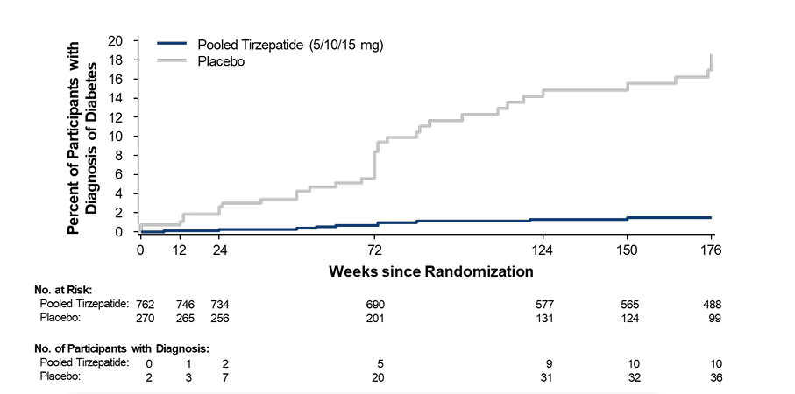
SURMOUNT-1
PERCENTAGE OF PARTICIPANTS WITH DIABETES AT 176 WEEKS
†
93% lower risk in the Tirzepatide group
Jastreboff, A. M. et al. N Engl J Med 2024

Slide 11
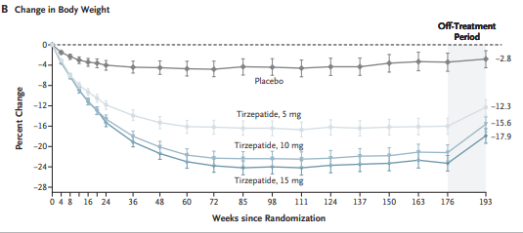
SURMOUNT-1
Three-year study
Jastreboff, A. M. et al. N Engl J Med 2024

Slide 12
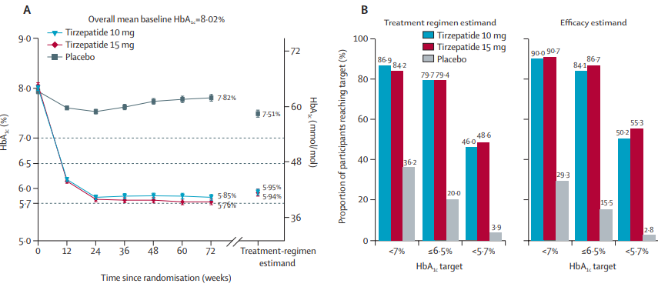
SURMOUNT-2
HbA1c OVER TIME AND PROPORTION OF PARTICIPANTS REACHING HbA1c TARGETS
Garvey WT et al. Lancet 2023

Slide 13
SURMOUNT-3
.
Wadden TA, et al. Nat Med. 2023
Phase 3, randomized, double-blind, multicenter, parallel-group,
placebo-controlled trial at 62 sites in 3 countries (NCT04657016)
Screening
(2 week)
Study period I
Follow-up period
(4 week)
Study period IV
12-Week lead-in
Study period II
(Intensive lifestyle intervention)
Study period III
(72-week treatment)
1200-kcal/day Diet (women)
1500-kcal/day Diet (men)
+
Increased Physical Activity Program
Tirzepatide Once Weekly
2.5 mg
5 mg
7.5 mg
10 mg
12.5 mg
MTD 10 mg or 15 mg
Screening
Placebo
Adjunct to a reduced calorie diet and increased physical activity
-14
-12
-10
-8
-6
-4
-2
0
4
8
12
16
20
72
76
Dose escalation period
Maintenance period
Randomizationª
1:1
(Week 0)
Primary endpoint
(Week 72)
ªOnly those patients who were able to achieve ≥5% weight reduction at the end of the lead-in period were randomized. MTD=Maximum Tolerated Dose.

Slide 14

SURMOUNT-3
Change in Body Weight From Lead-in Period to Week 72
.
Wadden TA, et al. Nat Med. 2023
Observed Value
Observed Value

Slide 15
SURMOUNT-3
Change in Body Weight From Randomization to Week 72
-24.4%
.
Wadden TA, et al. Nat Med. 2023

Slide 16
SURMOUNT-3
Percentage of Participants Achieving Weight Loss Targets
From Randomization (Week 0) to Week 72
.
Wadden TA, et al. Nat Med. 2023

Slide 17
SURMOUNT-4
1
Key Inclusion Criteria
  Age ≥18 years
BMI
≥30 kg/m² or
≥27 kg/m² and at least 1 weight-related comorbidity (hypertension, dyslipidemia, obstructive sleep apnea, cardiovascular disease)
History of ≥1 self-reported unsuccessful dietary effort to lose body weight
2-Week
Screening
36-Week Lead-in Open Label
Tizepatide Treatment
52-Week Double –Blind Treatment
4-Week Safety
Follow-up
10 mg or 15 mg
Tirzepatide 10 mg or 15 mg QW
10 mg
Tirzepatide 10 mg or 15 mg QW
Screening
5 mg
12.5 mg
2.5 mg
7.5 mg
2
Key Exclusion Criteria
Injectable Placebo QW
Adjunct to a reduced calorie diet and increased physical activity
Type 1 or Type 2 Diabetes mellitus
Change in body weight >5 kg within 3 months prior to screening
Prior or planned surgical treatment for obesity
Treatment with a medication that promotes weight loss < 3 months prior to enrollment
-2
0
4
8
12
16
20
36
88
92
Dose Escalation
Lead-in Enrollment
Randomization 1:1
Primary End Point
End of Treatment Period
Aronne LJ et al. JAMA 2024

Slide 18
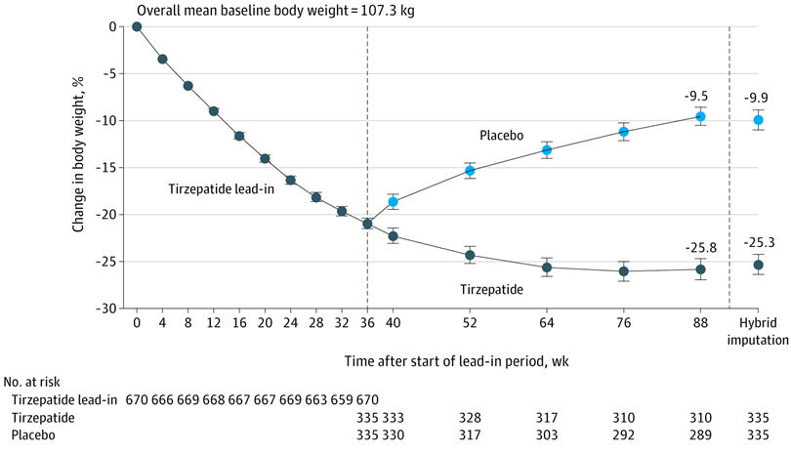
SURMOUNT-4
Change in Body Weight from Week 0 to Week 36
Percent Change in Body Weight
-20.9%
Aronne LJ et al. JAMA 2024

Slide 19
SURMOUNT-4
Change in Body Weight from Week 0 to Week 88
Percent Change in Body Weight
-20.9%
Aronne LJ et al. JAMA 2024

Slide 20
WEIGHT LOSS WITH TIRZEPATIDE IN SURMOUNT STUDIES
Summary: SURMOUNT 1-4
SURMOUNT-1 | SURMOUNT-2 | SURMOUNT-3 |  | SURMOUNT-4
Weight | Weight in T2D | Weight after Instensive Lifestyle Intervention (ILI) |  | Weight management after initial weight loss with tirzepatide
105,3 kg | 100,8 kg | 109,5 kg | 101,9 kg | 107,3 kg | 85,2 kg
after 72 weeks | after 72 weeks | 12 weeks of ILI Lead-In | after 72 weeks (including admission) | 36 weeks | after 88 weeks (including admission)
Starting Weight
Change in body
weight (%)
Aronne LJ et al. JAMA 2024
Garvey WT et al. Lancet 2023
.
Wadden TA, et al. Nat Med. 2023
Jastreboff, A. M. et al. N Engl J Med 2022

Slide 21
SIDE EFFECTS SURMOUNT -1
Jastreboff, A. M. et al. N Engl J Med 2022

Slide 22
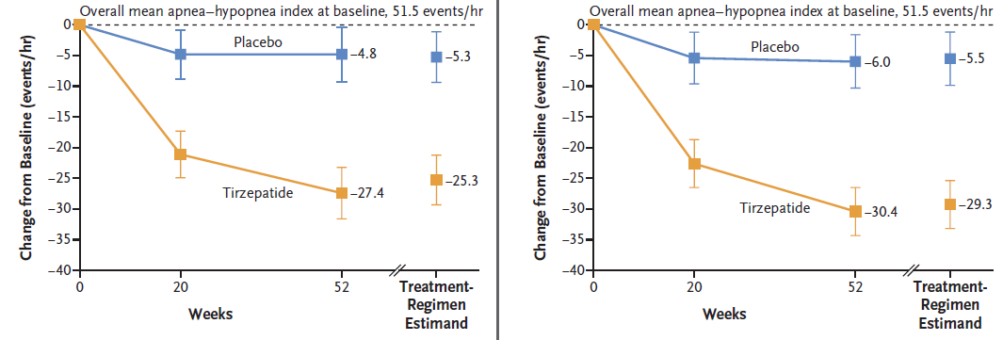
SURMOUNT- OSA
Change in AHI
TRIAL 1 (NO C-PAP)
TRIAL 2 (C-PAP)
ETD = 20 events per hour
ETD = 23.8 events per hour
Malhotra, A. et al. N Engl J Med 2024

Slide 23
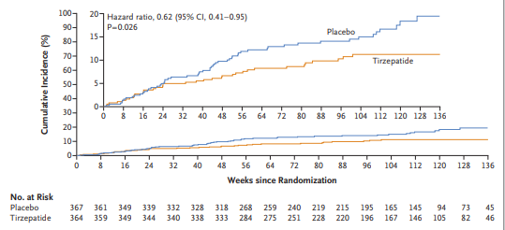
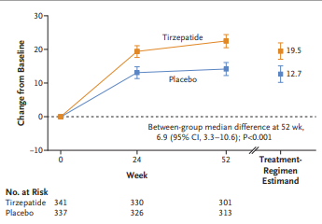
SURMOUNT-SUMMIT
HEART FAILURE WITH PRESERVED EJECTION FRACTION AND OBESITY
Packer M et al NEJM 2025

Slide 24
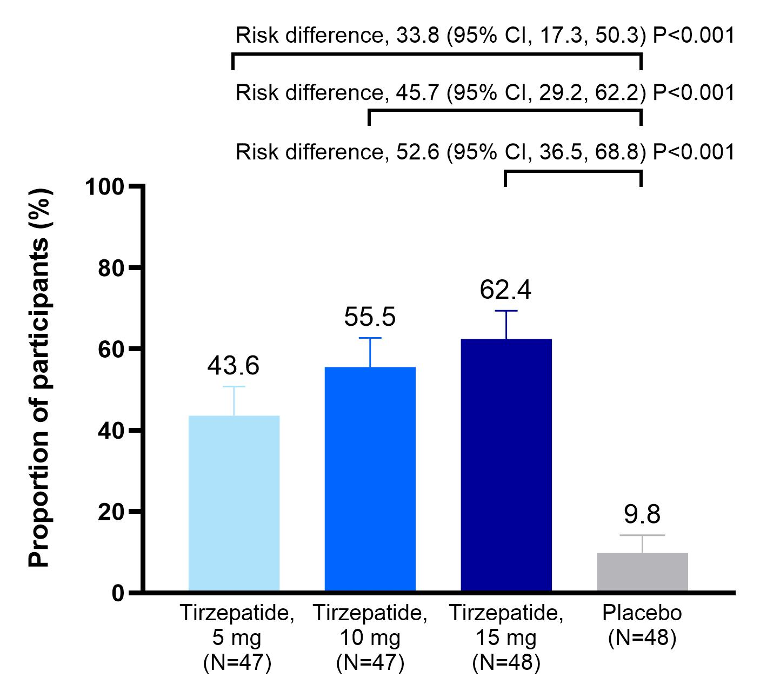
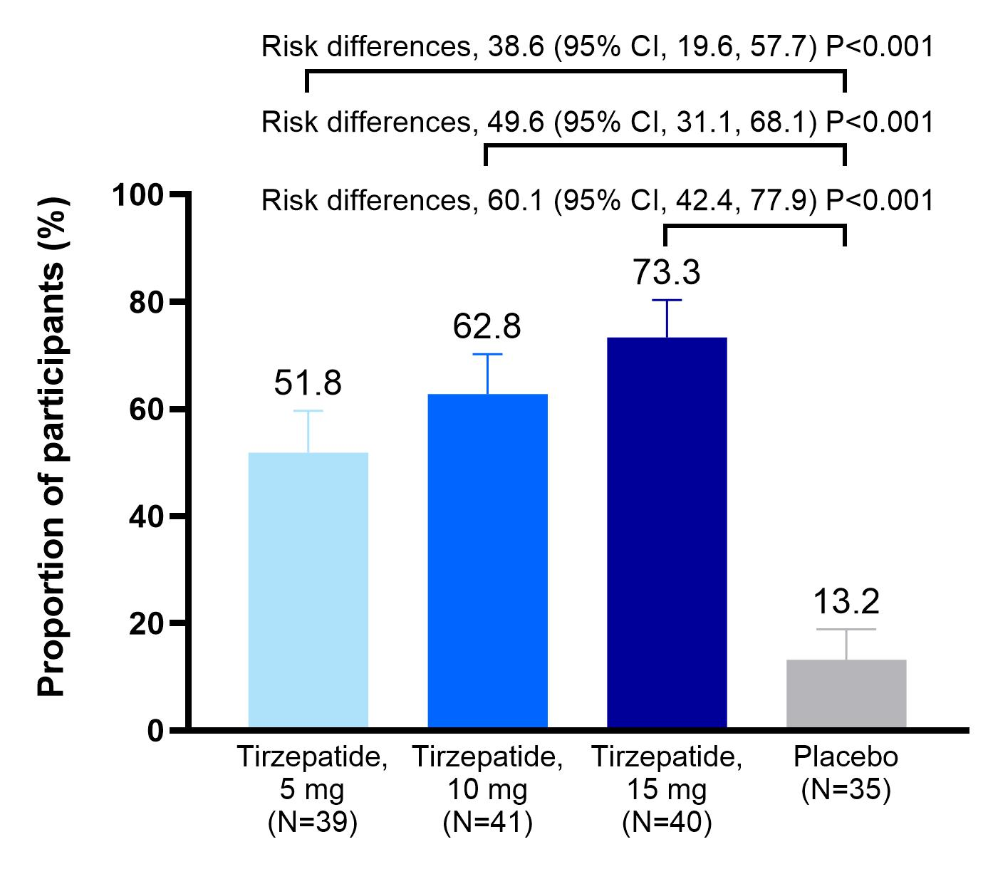
SURMOUNT-SYNERGY
Resolution of MASH and no worsening of fibrosis
Treatment Regimen Estimand
Efficacy Estimand
Loomba R et al. 2024 NEJM
Notes:
Treatment regimen estimand: included all randomized patients with missing values in the treatment groups imputed assuming they follow the pattern of the placebo group
Efficacy estimand for primary endpoint: included data from all randomized subjects excluding data after permanent study drug discontinuation

Slide 25
CONCLUSIONS
Tirzepatide once weekly provided:
A substantial and sustained reduction (3 years) in body weight.
Normoglycaemia (HbA1c<5·7%) in nearly half of the diabetic participants versus 3% treated with placebo
Substantial additional reduction in body weight in participants who had achieved ≥5.0% weight reduction with intensive lifestyle intervention.
A significant and clinically relevant decrease in Apnoea-Hypopnea compared to placebo.
MASH resolution in 44-62% of participants compared to 9.8% of those treated with placebo.
A lower risk of a composite of death from cardiovascular causes or worsening heart failure than placebo and improved health status in patients with heart failure with preserved ejection fraction and obesity.

Slide 26
Grazie

